Slide 1
ASIA-PACIFIC TRAINING CURRICULUM ON GENDER STATISTICS
Finding the right gender data and conducting basic analysis

Slide 2
What makes gender data right?
1

Slide 3
‘Right’ gender data
How to select better gender data?
Relevant: Users should need/want to use it
Coherent: Data based on compatible concepts and definitions
Comparable: Data comparable over time and across countries
Accurate: Closeness between data and the reality
Reliable: Data obtained at two different times should match with each other
Timely: Time-period for which the data is of value or can be acted upon
Accessible: Users should be able to readily and freely access the data
Interpretable: The ease with which users can understand and properly use data

Slide 4
Where to find the right gender data?
2

Slide 5
Which data source is better? Official or non-official?
Official statistics
Produced by either the National Statistics Office or another government body in charge of data production (e.g. line ministries, National Meteorology Agency, etc.)
Produced in accordance with the National Statistics Law/Act and in line with the Fundamental Principles of Official Statistics
Produced by a third-party organization but cleared by the National Statistical Authority (e.g. National Statistical Office, Statistical Capacity Building Trust)
Some examples: Figures derived from Census data, official surveys, administrative records
Non-official statistics
Produced by third-party organizations without the involvement of national statisticians
Often narrower in coverage (especially regarding sample sizes)
Usually ad-hoc studies and one-off data collection experiments

Slide 6
Choosing official vs. non-official statistics
When to choose official statistics?
When looking for comprehensive and representative results
More representative of a country’s total population
More accurate results as sampling frame comes from Census
Large teams of enumerators trained on data-collection methods
Trained enumerators are best-placed to obtain accurate answers from respondents
More trained enumerators means questionnaires can be rolled out among larger population groups of different backgrounds
When to choose non-official statistics?
Choose non-official statistics when:
Official statistics are not available (e.g. new and emerging areas)
Conflict of interest (the data is about government corruption, good governance, etc.)
Either way, assess the quality of your data (by looking at and understanding the metadata)

Slide 7
Global sources of gender data
1. Macrodata
National aggregates
When to choose macrodata?
When looking at national-level estimates
When looking for readily available estimates.
2. Microdata
Individual-level data (data collected from each individual through a survey or interview)
When to choose microdata?
When the existing macro or pre-processed microdata does not satisfy your research question
When you want to conduct advanced-level analysis

Slide 8
Global sources of gender data
Macrodata
Some sources of global macro gender data are:
UN Women’s Data Portal https://data.unwomen.org/data-portal
Official SDG database: https://unstats.un.org/sdgs/indicators/database/
World Development Indicators: https://data.worldbank.org/
Websites of specialized UN agencies: (e.g. UNICEF for children, UNESCO for education, WHO for health, etc.)

Slide 9
Global sources of gender data: Macrodata
1.1. UN Women’s data portal
Free access to gender data
Data can be used to monitor the SDGs and other gender indicators
Can view gender data, stories, analysis about the lives of women and girls
Many types of data can be downloaded:
Regional aggregates for gender-related SDG indicators
National estimates for any country and year
Country data for select non-SDG indicators

Slide 10
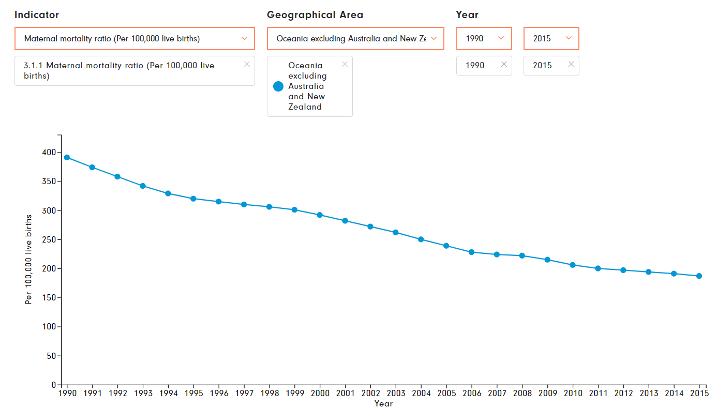
Global sources of gender data: Macrodata
UN Women’s data portal: Regional aggregates for SDG indicators
Maternal mortality ratio in Oceania, excluding Australia and New Zealand (1990-2015)

Slide 11
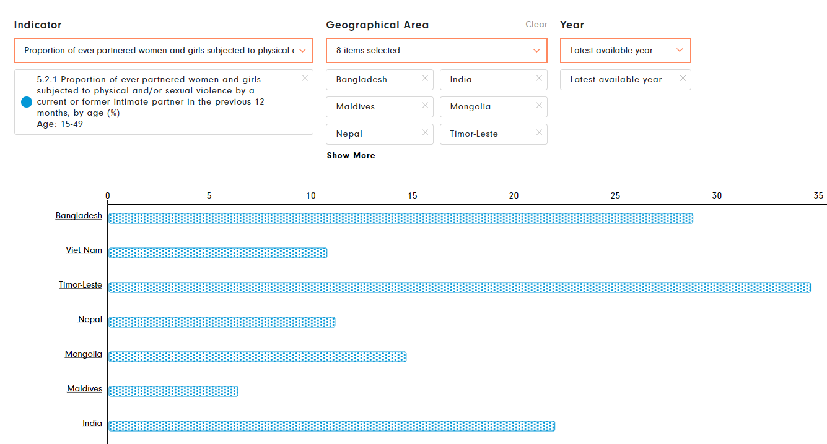
Global sources of gender data: Macrodata
UN Women’s data portal: National estimates
Proportion of ever-partnered women and girls subjected to physical and/or sexual violence by a current or former intimate partner in the previous 12 months

Slide 12
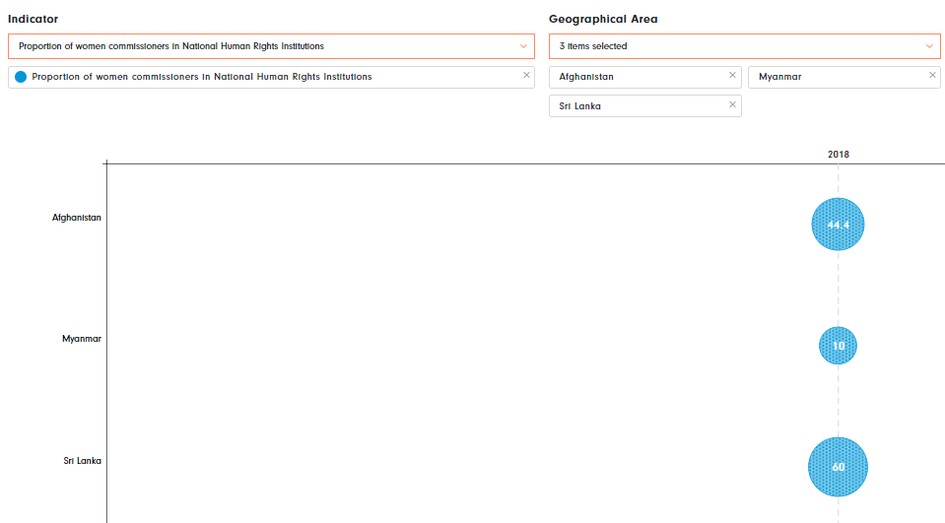
Global sources of gender data: Macrodata
UN Women’s data portal: Country data for select non-SDG indicators
Proportion of women commissioners in National Human Rights Institutions

Slide 13
Global sources of gender data: Macrodata
1.2. Official SDG Global Indicators Database
Access to data compiled through the UN system
Free access to country-level data for all SDG indicators
SDG dashboard: interactive platform to track, monitor and report on the SDG data
Types of data available:
Country-level data for an indicator, across all countries and years
Global or regional aggregates for all indicators, across years
National figures for a certain country and indicator, across years

Slide 14
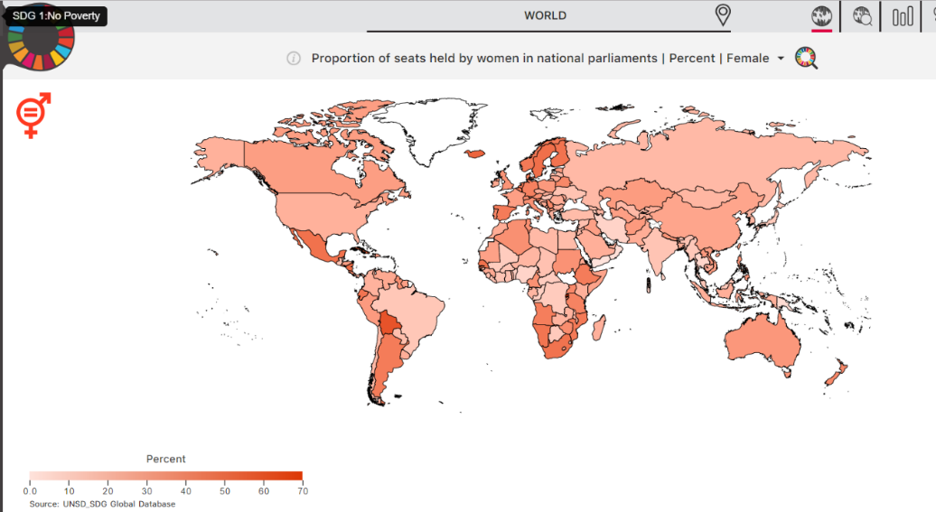
Global sources of gender data: Macrodata
Country-level data for an indicator, across all countries and years
Proportion of seats held by women in national parliaments (%)

Slide 15
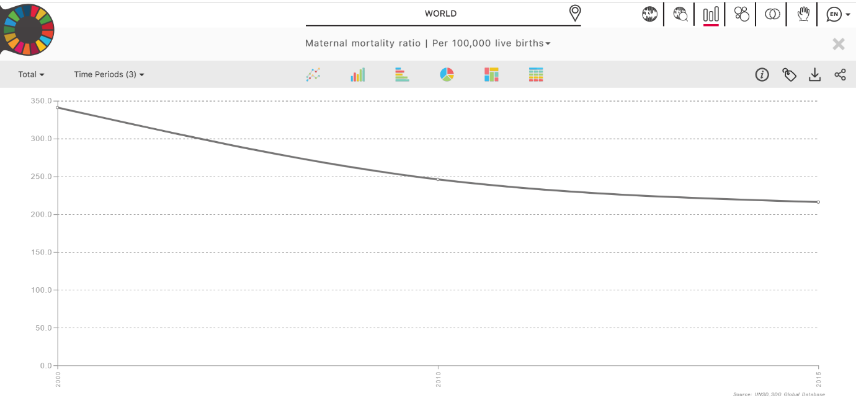
Global sources of gender data: Macrodata
Global or regional aggregates all indicator, across years
Global estimates for maternal mortality ratio across multiple years

Slide 16
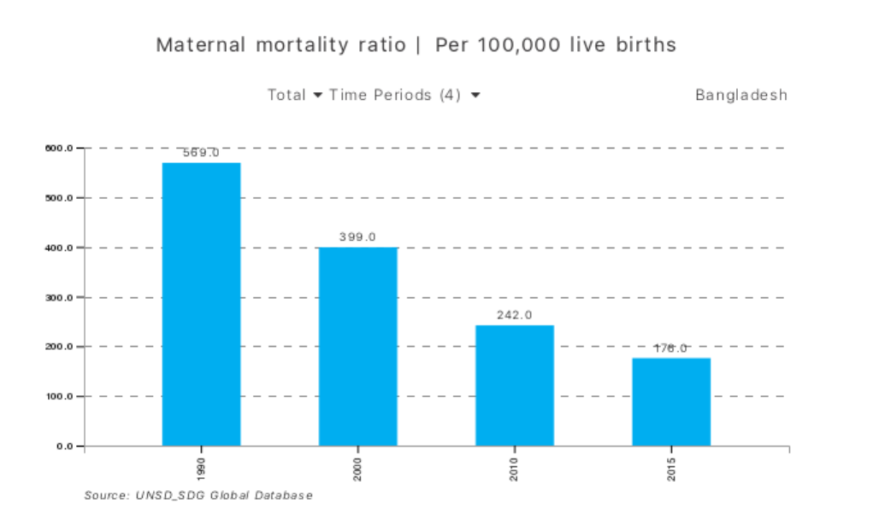
Global sources of gender data: Macrodata
National figures for a certain country and indicator, across years
Maternal mortality ratio for Bangladesh across four time periods

Slide 17
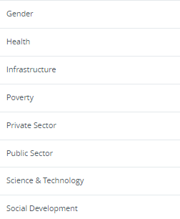
Global sources of gender data: Macrodata
1.3. World Development Indicators
Global development data
User can search data by indicator or by country
Users can customize searches by theme
Types of macrodata that can be found include:
Global trends for an indicator
Regional aggregates for select indicators and regions
Thematic areas in World Bank's Global Development Repository

Slide 18
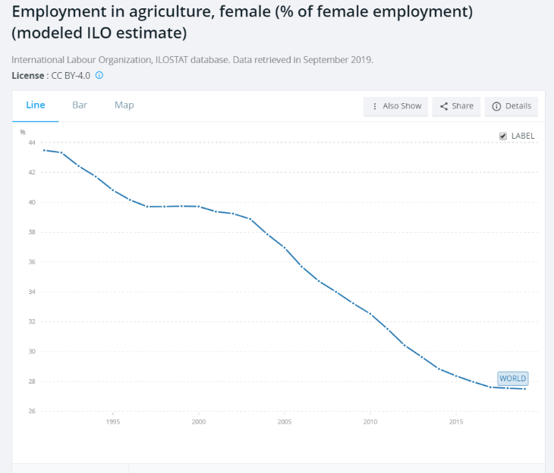
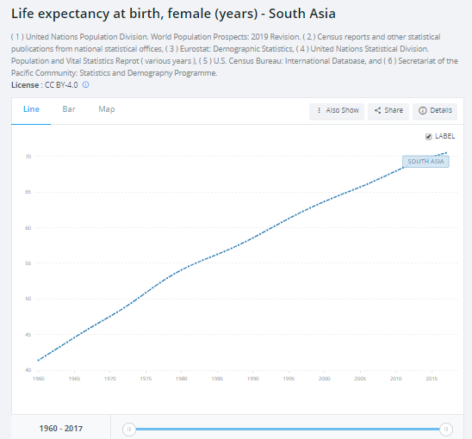
Global sources of gender data: Macrodata
Global trends for a certain indicator
Regional aggregates for select indicators and regions
World Bank Global estimates on female employment in agriculture
Female life expectancy at birth, South Asia

Slide 19
Global sources of gender data: Microdata
2. Microdata
Examples of repositories include:
DHS (Demographic and Health Surveys) STATcompiler https://statcompiler.com/en/
IPUMS International and IPUMS Tabulator https://international.ipums.org/international/
DHS datasets https://www.dhsprogram.com/data/available-datasets.cfm
MICS datasets http://mics.unicef.org/surveys

Slide 20
Global sources of gender data: Microdata
DHS (Demographic and Health Surveys) STATcompiler
Pre-processed microdata and simple summary statistic
User can select indicators of interest, population groups to obtain aggregates
Data can be disaggregated by age, sex, wealth, location, etc.
Limitation in terms of simultaneous disaggregation by more than one variable.
For e.g. data can be obtained for poorest and richest or rural and urban but not poorest people living in rural locations
DHS STAT compiler allows for disaggregation of data by location of residence and wealth

Slide 21
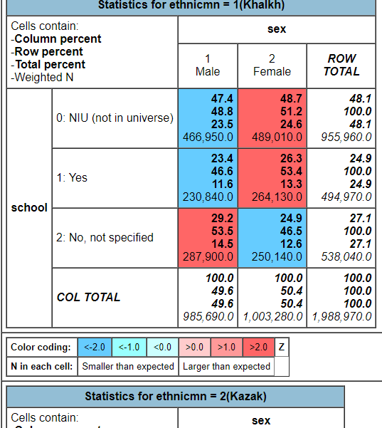
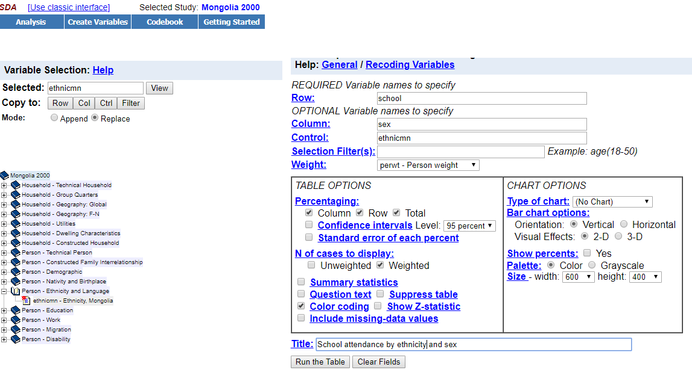
Global sources of gender data: Microdata
IPUMS International and IPUMS Tabulator
Harmonized Census data
User can download microdata from Censuses across different countries and years
Data can be analysed using statistical packages such as STATA or SAS
IPUMS Tabulator for online analysis
Output resulting from IPUMS tabulator for specific selection of indicator, year, sex and ethnicity.
Dialogue box for IPUMS Tabulator

Slide 22
Global sources of gender data: Microdata
Microdata: DHS and MICS datasets
If research question is not satisfied with macrodata or pre-processed microdata
MICS and DHS are very similar surveys
Capture specific social, demographic and health issues
Issues to consider before using household survey data for gendered analysis
Sampling method
Who is interviewed?
Timeliness of data
International comparability

Slide 23
Global sources of gender data: Microdata
Microdata: DHS and MICS datasets
Issues to consider before using household survey data for gendered analysis
Sample size
Who is interviewed?
Timeliness
International comparability
Nationally representative
Sample size large enough to disaggregate data
Both men and women are interviewed
This means women are sharing their own experience instead of a man sharing their experience
As compared to a census, which is collected once in 10 years, household surveys data is available once in 5-7 years
Data is more relevant
Data is comparable across countries and time
Standard definitions, classifications and concepts

Slide 24
National sources of gender data
Some examples of national online sources of gender data:
National Statistical Offices website
Websites of national statistical coordination mechanisms
Websites of ministries of education, labour, justice, etc. (data-producing ministries)
Data repositories of police, military
Data repositories of electoral management bodies
National SDG website (usually managed by NSO or Ministry of Planning)
National gender statistics database (usually managed by Ministry of Women and/or NSO)

Slide 25
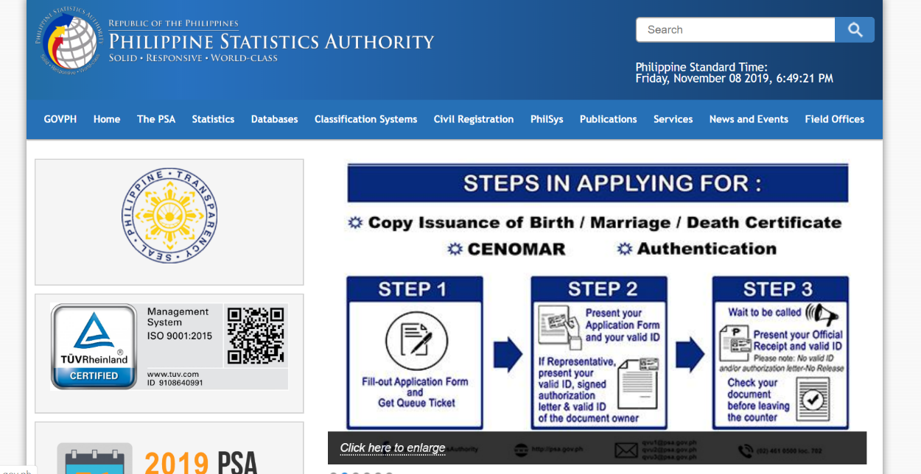
National sources of gender data
National Statistical Office (NSO) website
The NSO is primarily responsible for collecting, compiling and releasing official statistics
Generally, NSOs have a website where data is released for users
Users can also request access to microdata
Philippines Statistical Authority Homepage

Slide 26
3
Basics of gender data analysis

Slide 27
The basics of gender data analysis
Complex process of analyzing individual-level records through statistical software
To assess results from a gender perspective
Follow these steps to perform gender data analysis
Key considerations
Do you have a research question?
- Clear, concise and arguable question
- E.g. Is unemployment rate equal for all population groups?
Is there background information to help your analysis?
-E.g. I suspect unemployment rate is higher among women ages 15-29 living in rural areas because women’s rights advocates have been raising this issue lately
Is enough information available for you to use pre-processed data ?
- International estimates
- National databases/reports with official statistics
- Micro databases
Is there data to conduct additional analysis (to answer the research question)?
E.g. You might need correlation analysis to see if employment and educational attainment are associated

Slide 28
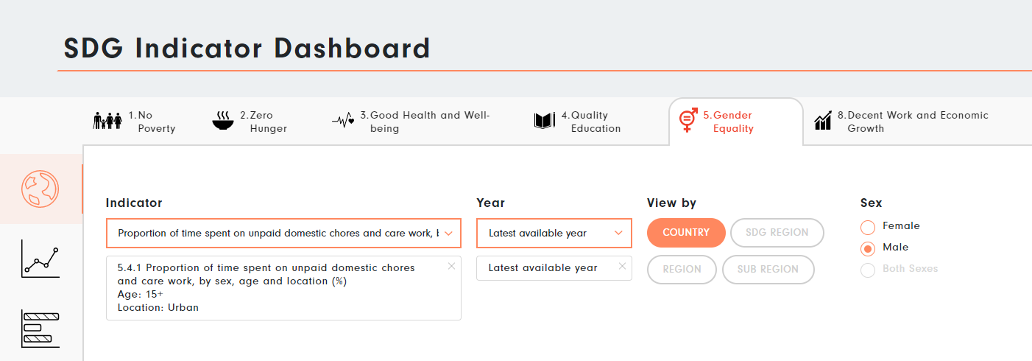
How to conduct gender data analysis
1. Macrodata from UN Women Gender Data Portal
E.g. Calculating the proportion of women ages 20–24 who were married as children
Step 1: Go to the Women Count Hub https://data.unwomen.org/data-portal
Step 2: Scroll down to see other dashboards
Step 3: Select Dashboard no. 2, ‘SDG Indicators’
SDG Indicator Dashboard

Slide 29
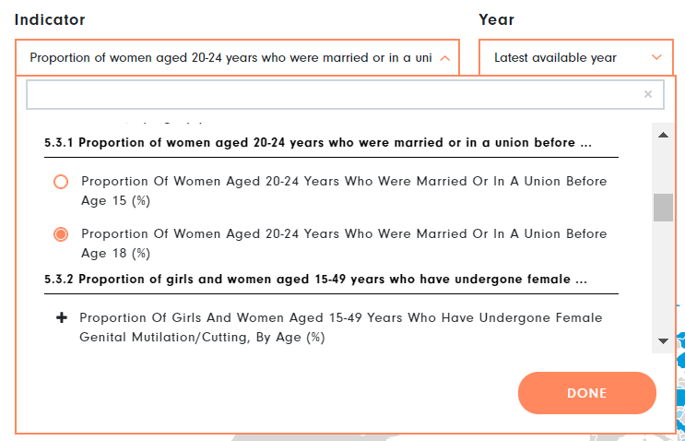
How to conduct gender data analysis
1. Macrodata from UN Women Gender Data Portal
Step 4:
Select indicator 5.3.1 ‘Proportion of women aged 20-24 years who were married or in a union before age 15 and before age 18’
from the drop-down list of indicators:
List of indicators on the SDG Indicator Dashboard

Slide 30
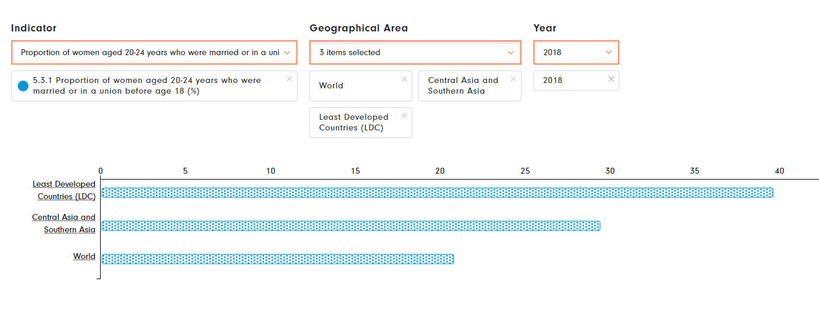
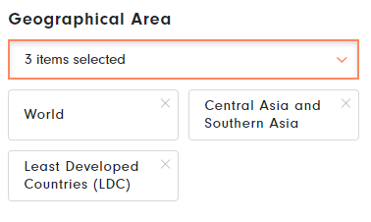
How to conduct gender data analysis
1. Macrodata from UN Women Gender Data Portal
Step 5: Select 2018 from ‘year’
Step 6: Select ‘SDG’ regions from the ‘View by’ options
Step 7: Make a further selection on the regions to respond to the research question.
Step 8: Select the desired type of visualization
Bar graph reflecting the selections made on the dashboard
Dialogue box for selection of geographical areas

Slide 31
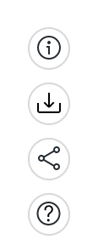
How to conduct gender data analysis
1. Macrodata from the UN Women Gender Data Portal
Step 9: Further selections are possible for the following actions:
Icons to make additional selections
Metadata for this data
Download the dataset as a PDF or CSV file
Share the link of the webpage
Find out additional information/help

Slide 32
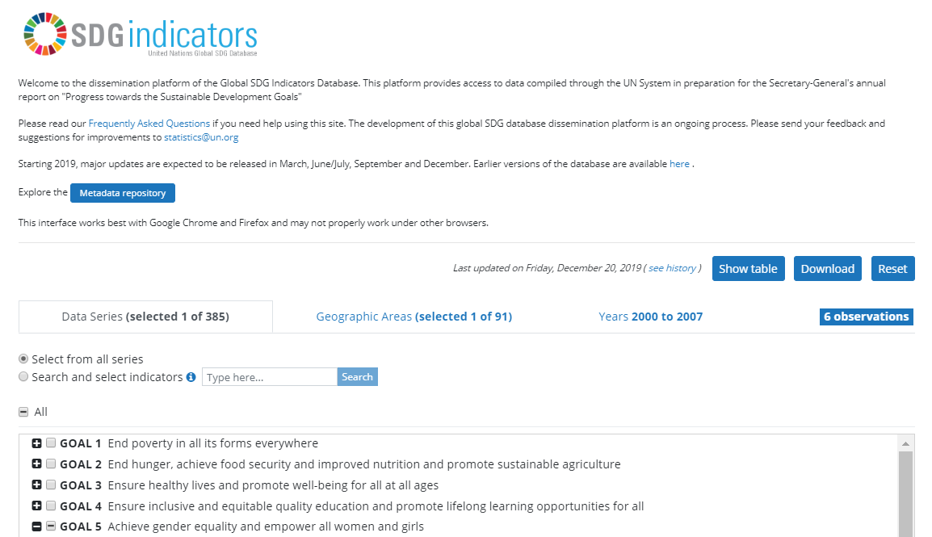
How to conduct gender data analysis
2. Macrodata data from the Global SDG Indicators Database
Step 1: Go to global database

Slide 33
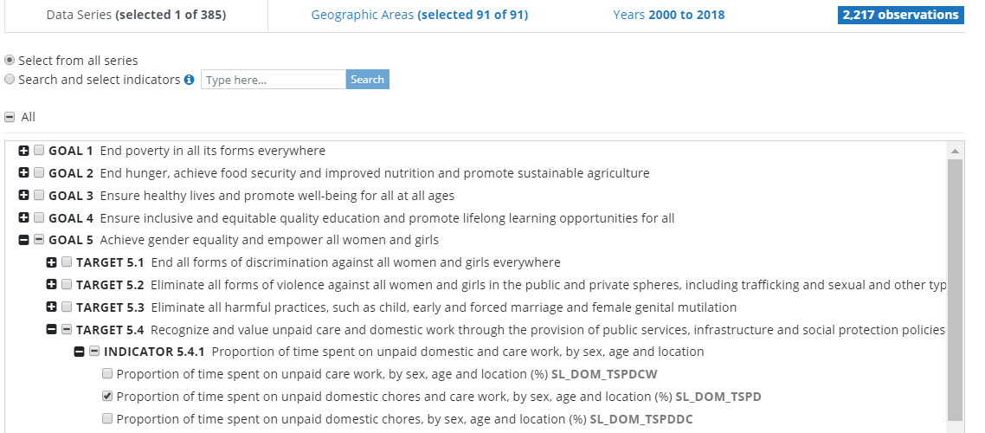
How to conduct gender data analysis
2. Macrodata from the Global SDG database
Step 2: Read the relevant metadata to assess the quality of data
Step 3: Select the data series
Goal 5 indicators represented in a 'tree’ search structure

Slide 34
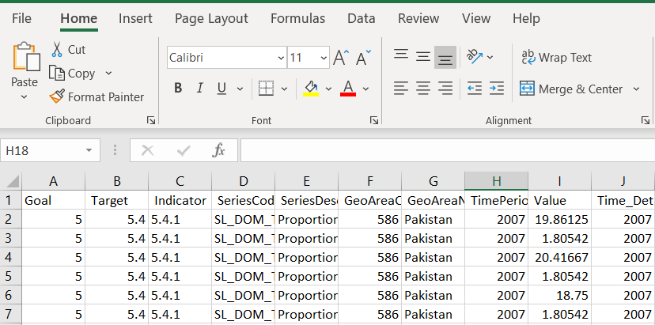
How to conduct gender data analysis
2. Macrodata from the Global SDG database
Step 4: Select the country of interest
Step 5: Select the download option to view the results on an Excel sheet
Excel file showing SDG Indicator 5.4.1 data for Pakistan

Slide 35
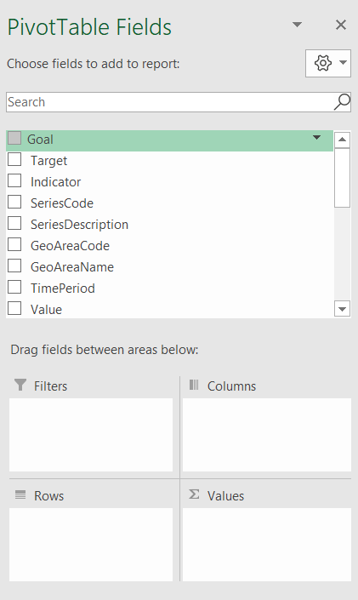
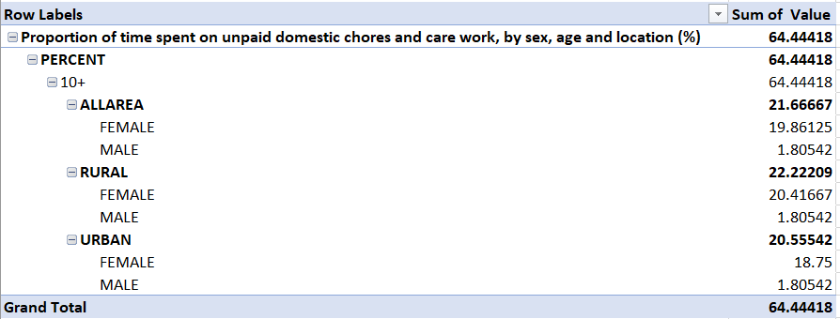
How to conduct gender data analysis
Pivot table fields to create customized table
2. Macrodata from the Global SDG Indicators Database
Step 6: Create a pivot table by selecting the data and then the ‘PivotTable’ option
Step 7: Customize the rows and columns of the Pivot Table
Drag ‘Series description’ to ‘Filters’
Drag ‘Value’ to ‘Sum of Values’
Drag ‘Unit’, ‘Age’, ‘Location’ and ‘Sex’ to ‘Rows’
Pivot table showing % time spent on unpaid care and domestic work in Pakistan, disaggregated by sex and location

Slide 36
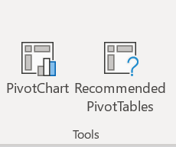
How to conduct gender data analysis
2. Macrodata from the Global SDG database
Step 8: Select the data and click on ‘insert PivotChart’
Proportion of time spent on unpaid care and domestic chores, by sex and location
Dialogue box showing Pivot chart options

Slide 37
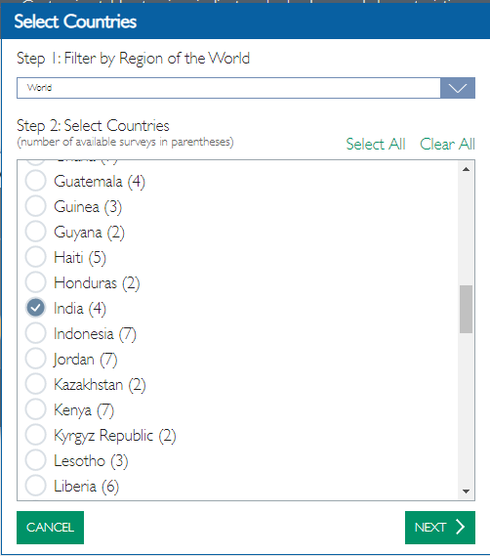
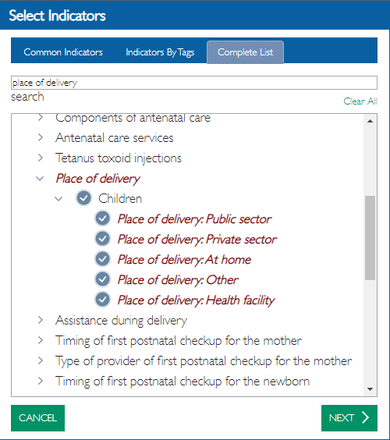
How to conduct gender data analysis
3. Pre-processed microdata from DHS STATcompiler
E.g. proportion of women who deliver at home vs. elsewhere in India
Step 1: Select the country and indicator
Result table showing proportion of women having access to public, private, home and other place of delivery in India
Dialogue box for list of countries and indicators in DHS STATcompiler

Slide 38
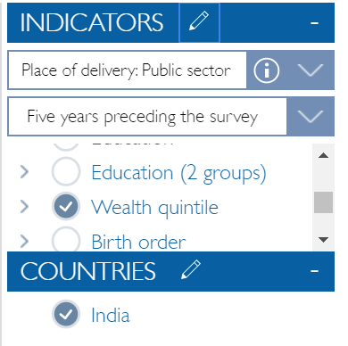
How to conduct gender data analysis
3. Pre-processed microdata from DHS STATcompiler
Step 2: Disaggregate the data by wealth by selecting the wealth quintile option
List of disaggregation variables
Result table showing proportions of women who delivered at home, by wealth

Slide 39
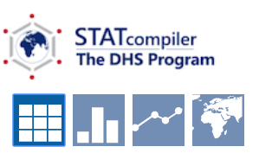
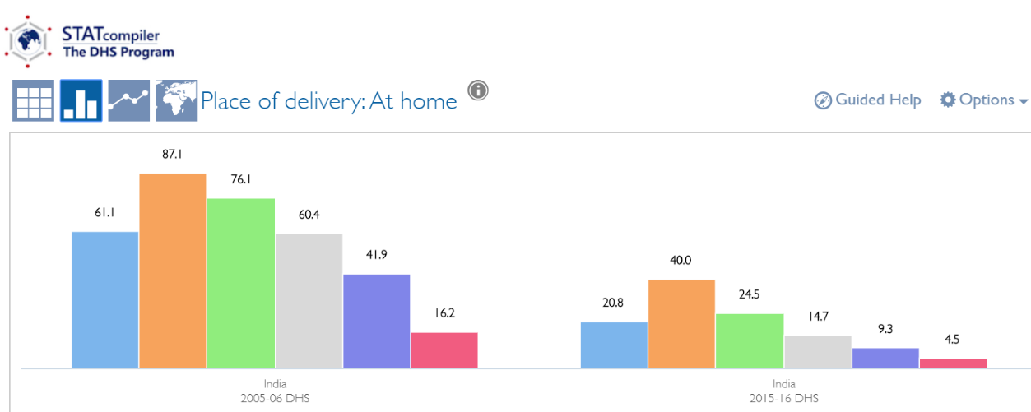
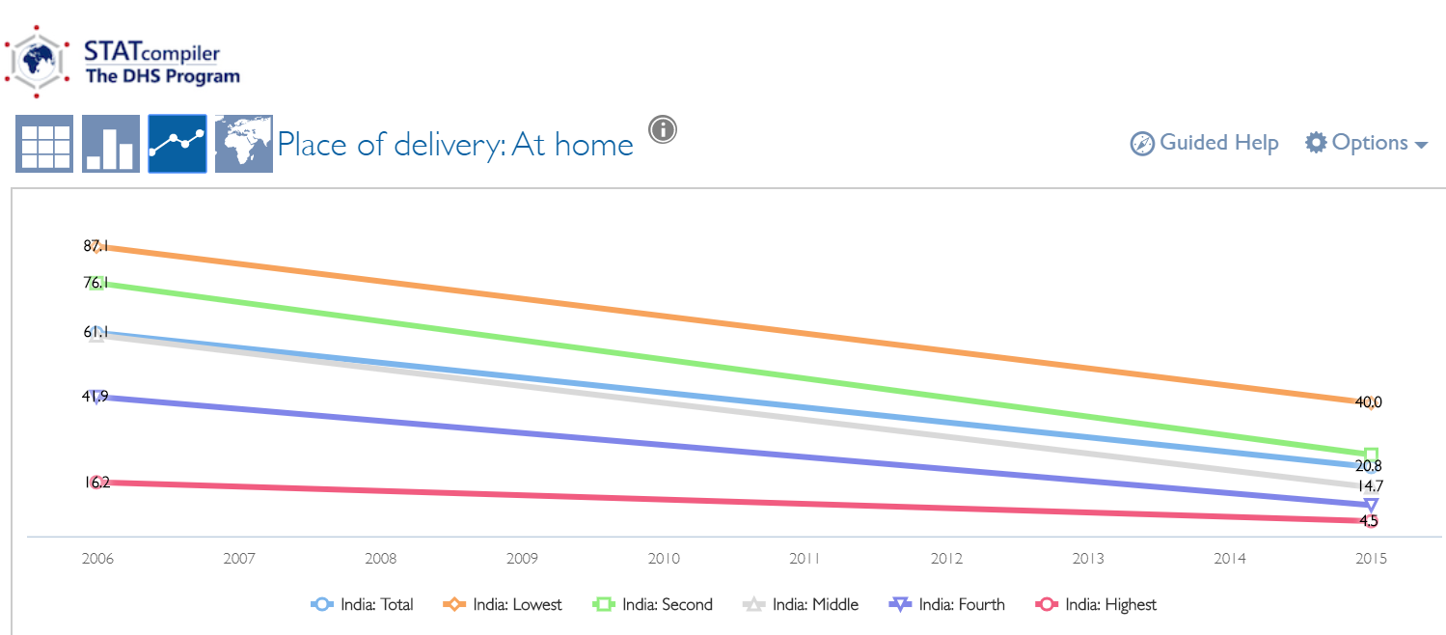
How to conduct gender data analysis
Data visualization icons
3. Pre-processed microdata from DHS STATcompiler
Step 3: Visualize data by selecting the chart option
Column and line graphs representing proportion of women who delivered at home

Slide 40
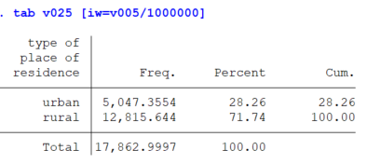
How to conduct gender data analysis
4. Microdata from Demographic and Health Surveys
E.g. Proportion of women living in rural locations in Bangladesh (2014, DHS data)
Step 1: Open the microdata by double clicking the IR file in STATA
Step 2: Use recode variable v025 (location of residence) to identify respondents located in rural areas
Step 3: Tabulate the variable v025 to see the percentage of people who live in urban areas, by typing tab v025 [iw = v005/1000000]
Result table showing distribution of women across location of residence

Slide 41
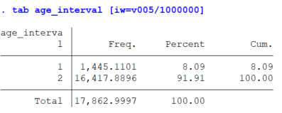
How to conduct gender data analysis
4. Microdata from Demographic and Health Surveys
E.g. Proportion of women in the age group 15–18, 19–59, and 50+
Step 1: Generate a new variable named ‘age_interval’ by typing generate age_interval=0
Step 2: Replace the value of 0 with 1 in those cases in which respondents ages fall between the age group 15–18 years.
- Type replace age_interval=1 if v012>14 & v012<19
Step 3: Replace the value of age_interval with 2 if the respondents are in the age group 19–49 years
- Type replace age_interval=2 if v012>18 & v012<50
Step 4: Allocate any missing values in your initial variable to your new variable by typing replace age_interval=. if v012==.
Step 5: Tabulate the results using appropriate sampling weights, by typing tab age_interval [iw=v005/1000000]
Result table showing distribution of women across different age groups

Slide 42
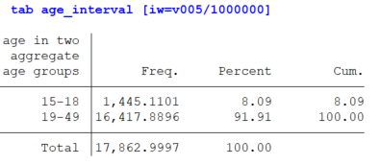
How to conduct gender data analysis
4. Microdata from Demographic and Health Surveys
Step 6: To label the age groups, type label var age_interval “age in three aggregate age groups”
Step 7: Type label define age_interval 1”15-18” 2”19-49” 3”50+” and then label values age_interval age_interval
Step 8: Tabulate the results by typing tab age_interval [iw=v005/1000000]
Result table showing distribution of women's sample by age, with appropriate labelling

Slide 43
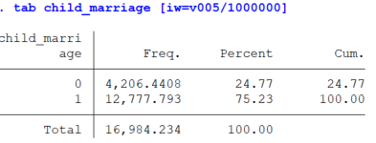
How to conduct gender data analysis
4. Microdata from Demographic and Health Surveys
E.g. Proportion of women who got married as children (i.e. age at first marriage or cohabitation is less than 18 years)
Step 1: Open IR File in STATA
Step 2: Generate new variable ‘childmarriage’
gen child_marriage=0
Step 3: Replace childmarriage with a value of 1 if the age at first marriage is less than 18 years using replace child_marriage=1 if v511<18
Step 4: Replace all the missing values with a dot (.) replace child_marriage=. if v511==. |v012<18 (we cannot assume girls below the age current age of 18 years won’t get married before age 18)
Step 5: Tabulate the result with appropriate weights using tab child_marriage [iw=v005/1000000]
Result table showing proportion of women who were married as children in Bangladesh (DHS, 2014)

Slide 44
4
Key Takeaways

Slide 45
Key takeaways
Good data must be in line with statistical quality assurance frameworks: relevant, accurate, reliable, coherent, comparable, and are produced in a timely manner.
Official statistics, which are produced by institutions within the National Statistical System, are often more reliable.
Always read the metadata before using data.
Use microdata to customize your analysis when the figures you are looking for aren’t readily available.
When choosing microdata, be mindful of sampling techniques, survey respondents, timeliness and comparability of the data.
To conduct gender data analysis:
identify a research question,
collect background information,
look into readily processed data and,
if not available, find and analyze microdata to obtain a response to the research question.
The Global SDG Indicators Database is a good source of macro gender data. It includes many SDG data beyond gender statistics.
UN Women’s Data Hub includes a compilation of gender statistics only. Most are SDG statistics, but some go beyond.
STATcompiler includes processed survey data. It is helpful for users to compare survey data across countries and to conduct analysis with one level of disaggregation.
Microdata can be used to conduct tailored data analysis. However, familiarity with statistical software packages is a prerequisite.

